Slide 1
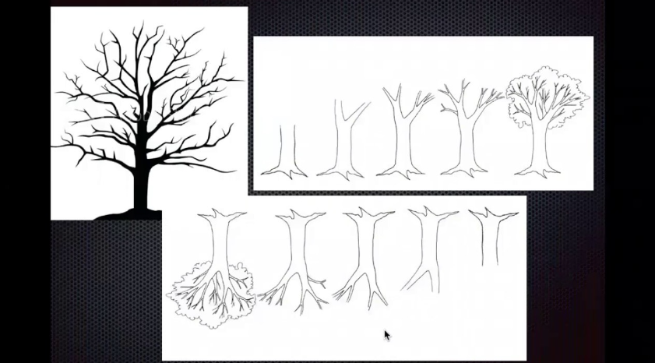
Tree Data Structure
Prepared & Present by:
Tanim Ahmed
Lecturer(CSE),DIU
B.Sc. in CSE,KUET

Slide 2
Outline
Pretest on this class
Definition
Properties
Tree Terminology
Application
Post Test on this class

Slide 3
What is Tree data structure
Tree is a non-linear data structure which organizes data in a hierarchical structure and this is a recursive definition.
OR
A tree is a connected graph without any circuits.
OR
If in a graph, there is one and only one path between every pair of vertices, then graph is called as a tree.

Slide 4
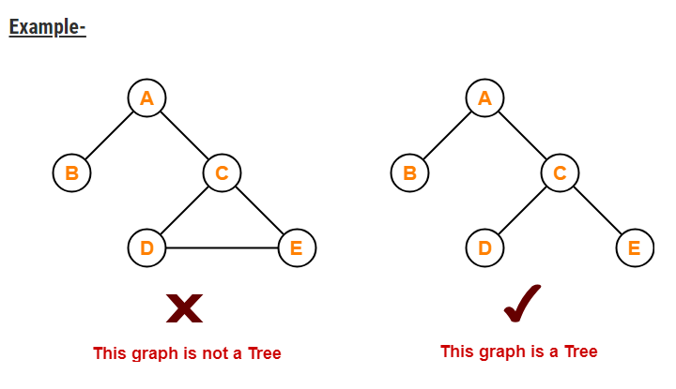
Example

Slide 5


Slide 6
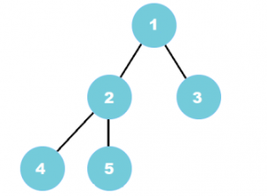
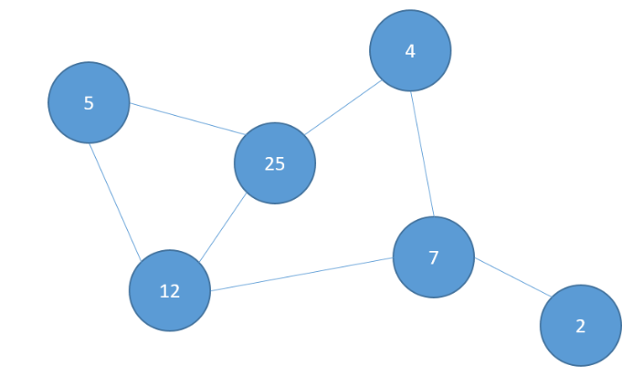
Is this a tree or not?

Slide 7
Answer
First is tree
Second is not tree because it contains cycle.

Slide 8
Properties
The important properties of tree data structure are-
There is one and only one path between every pair of vertices in a tree.
A tree with n vertices has exactly (n-1) edges.
A graph is a tree if and only if it is minimally connected.
Any connected graph with n vertices and (n-1) edges is a tree.

Slide 9
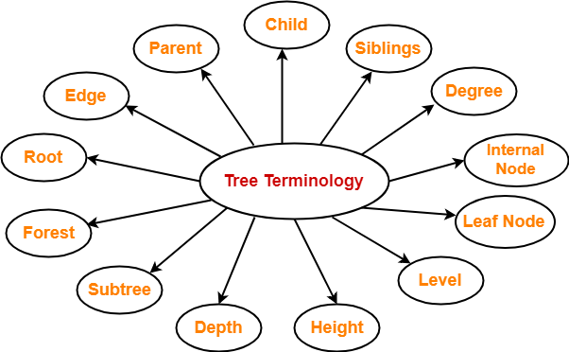
Tree Terminology

Slide 10
Root
The first node from where the tree originates is called as a root node.
In any tree, there must be only one root node.
We can never have multiple root nodes in a tree data structure.

Slide 11
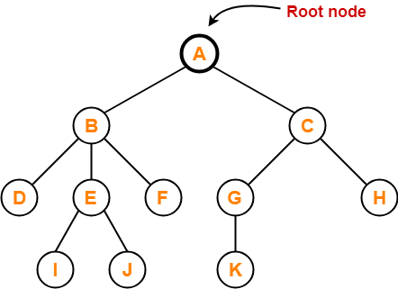
Example

Slide 12
Edge
The connecting link between any two nodes is called as an edge.
In a tree with n number of nodes, there are exactly (n-1) number of edges.

Slide 13
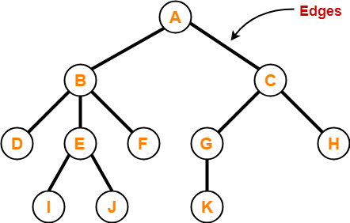
Example

Slide 14
Parent
The node which has a branch from it to any other node is called as a parent node.
In other words, the node which has one or more children is called as a parent node.
In a tree, a parent node can have any number of child nodes.

Slide 15
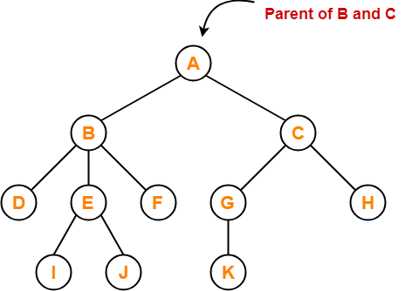
Example
Here,
Node A is the parent of nodes B and C
Node B is the parent of nodes D, E and F
Node C is the parent of nodes G and H
Node E is the parent of nodes I and J
Node G is the parent of node K

Slide 16
Child
The node which is a descendant of some node is called as a child node.
All the nodes except root node are child nodes.

Slide 17
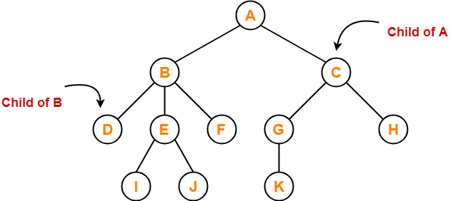
Example
Here,
Nodes B and C are the children of node A
Nodes D, E and F are the children of node B
Nodes G and H are the children of node C
Nodes I and J are the children of node E
Node K is the child of node G

Slide 18
Siblings
Nodes which belong to the same parent are called as siblings.
In other words, nodes with the same parent are sibling nodes.

Slide 19
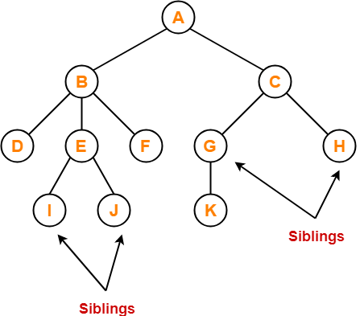
Example
Here,
Nodes B and C are siblings
Nodes D, E and F are siblings
Nodes G and H are siblings
Nodes I and J are siblings

Slide 20
Degree
Degree of a node is the total number of children of that node.
Degree of a tree is the highest degree of a node among all the nodes in the tree.

Slide 21
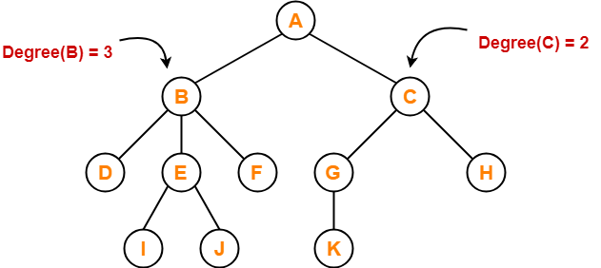
Example
Here,
Degree of node A = 2
Degree of node B = 3
Degree of node C = 2
Degree of node D = 0
Degree of node E = 2
Degree of node F = 0
Degree of node G = 1
Degree of node H = 0
Degree of node I = 0
Degree of node J = 0
Degree of node K = 0

Slide 22
Internal Node
The node which has at least one child is called as an internal node.
Internal nodes are also called as non-terminal nodes.
Every non-leaf node is an internal node.

Slide 23
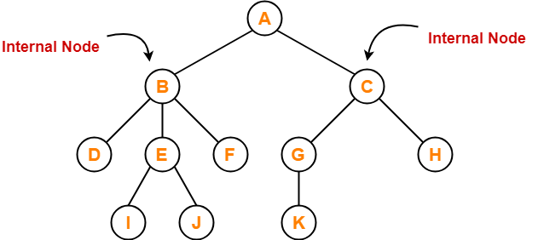
Example
Here, nodes A, B, C, E and G are internal nodes.

Slide 24
Leaf Node
The node which does not have any child is called as a leaf node.
Leaf nodes are also called as external nodes or terminal nodes.

Slide 25
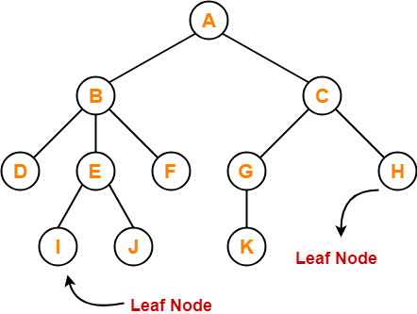
Example
Here, nodes D, I, J, F, K and H are leaf nodes.

Slide 26
Level
In a tree, each step from top to bottom is called as level of a tree.
The level count starts with 0 and increments by 1 at each level or step.

Slide 27
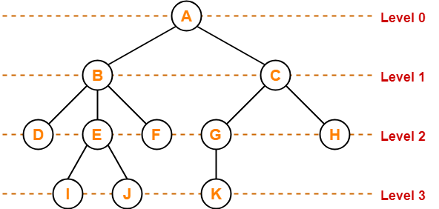
Example

Slide 28
Height
Total number of edges that lies on the longest path from any leaf node to a particular node is called as height of that node.
Height of a tree is the height of root node.
Height of all leaf nodes = 0

Slide 29
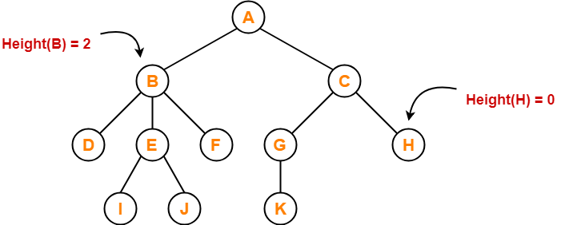
Example
Here,
Height of node A = 3
Height of node B = 2
Height of node C = 2
Height of node D = 0
Height of node E = 1
Height of node F = 0
Height of node G = 1
Height of node H = 0
Height of node I = 0
Height of node J = 0
Height of node K = 0

Slide 30
Depth
Total number of edges from root node to a particular node is called as depth of that node.
Depth of a tree is the total number of edges from root node to a leaf node in the longest path.
Depth of the root node = 0
The terms “level” and “depth” are used interchangeably.

Slide 31
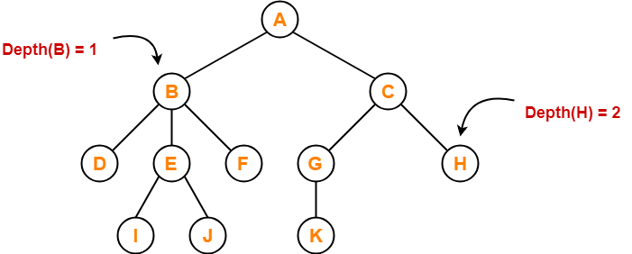
Example
Here,
Depth of node A = 0
Depth of node B = 1
Depth of node C = 1
Depth of node D = 2
Depth of node E = 2
Depth of node F = 2
Depth of node G = 2
Depth of node H = 2
Depth of node I = 3
Depth of node J = 3
Depth of node K = 3

Slide 32
Subtree
In a tree, each child from a node forms a subtree recursively.
Every child node forms a subtree on its parent node.

Slide 33
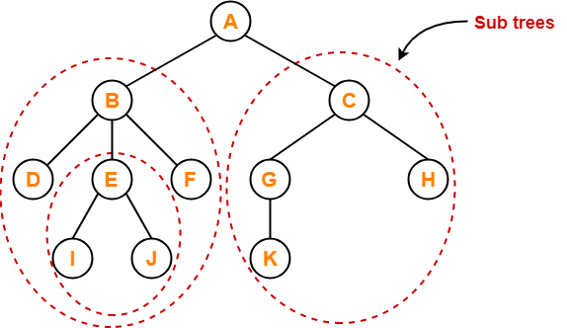
Example

Slide 34
Forest
A forest is a set of disjoint trees.

Slide 35
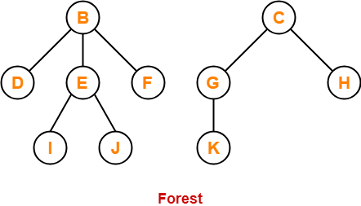
Example

Slide 36
Important Resources
visualising data structures and algorithms through animation – VisuAlgo
Algorithm Visualizer (algorithm-visualizer.org)

Slide 37

Application of Tree Data Structure
Youtube Link:
https://youtu.be/La8FqqD1Y08

Slide 38
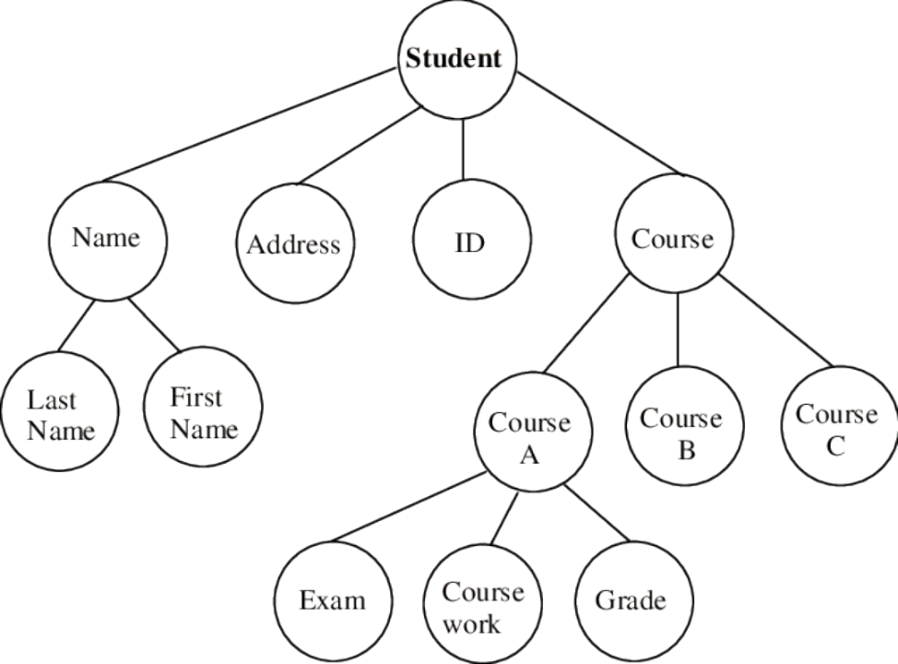
Home task
Find out all tree terminology from this tree
Root, internal node,child,parent,siblings,leaf node,height,depth

Slide 39
Reference
Books: Discrete Mathematics and its application,K.H. Rosen(Chapter-11)
Trees in Data Structure | Gate Vidyalay
Tree – javatpoint
Introduction to Tree - Data Structure and Algorithm Tutorials - GeeksforGeeks

